Slide 1
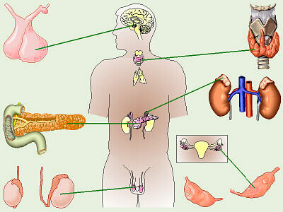
Intro to Endocrine System and Hormones
Ch 2 HP

Slide 2

Date: | Human Biology Year 12 ATAR
Do Now Get out your equipment and textbook. Lesson Agenda 1: Do Now 2: Intro to Endocrine System: Endocrine glands Hormone Clearance Control of Hormone Secretions 3: Get started on review worksheet Suggested Study Complete review worksheet, then mark and correct using the answers on Connect. Ms Byrne will check these tomorrow. NEXT LESSON How hormones impact the target cell Protein and Amine Hormones Steroid Hormones | Learning Aims Describe the function of the endocrine system. Define hormones, explain how they interact with cells and which cells may be affected. Describe hormone saturation Describe ways in which target cells respond to hormones Describe ways in which hormones are cleared from the body Briefly explain how hormone secretions are controlled
 | Key Vocabulary Endocrine Hormone Receptor Saturation Clearance Feedback

Slide 3
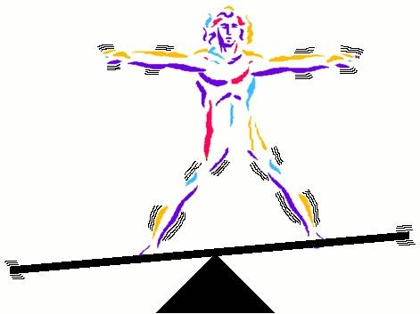
The body must maintain internal conditions (homeostasis)
Coordination of systems and organs is required to maintain health
The endocrine system is one aspect of this coordination
Messages must be sent between organs and systems so coordination can happen
Sensor: detects change to conditions and triggers messenger
Messenger: sends information to control centre/modulator
Control Centre/Modulator: processes information and triggers messenger
Messenger: takes instructions to effector
Effector: carries out instructions
Feedback mechanisms allow processes to stop when homeostasis has been reached
Maintains balanced internal environment

Slide 4
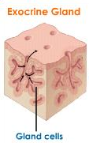
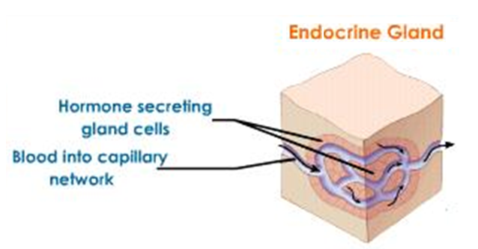
Glands – Exocrine and Endocrine
Exocrine glands:
Eg: sweat glands, mucous glands, salivary glands
Secretion travels down duct to local area eg. body surface, stomach.
Do not secrete hormones.
Endocrine glands:
Eg: pituitary, pineal, pancreas…
Secrete hormones into fluid surrounding cells, which then enters the blood stream.
No ducts

Slide 5
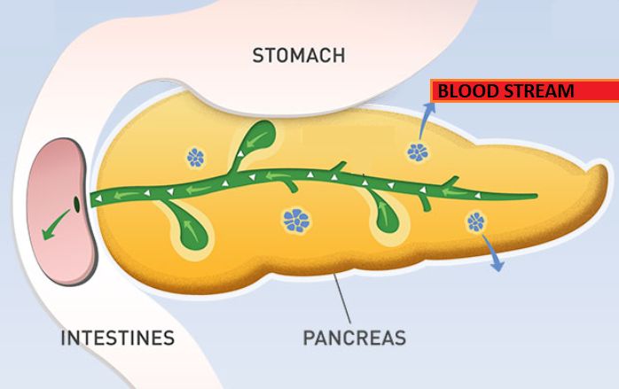
Eg: The pancreas has both exocrine and endocrine functions
The pancreas is an organ that has both exocrine and endocrine functions:
The exocrine pancreas is shown here in green and yellow. The tissue shown in yellow is exocrine gland tissue. It produces enzyme secretions that travel down ducts (shown in green) into the intestine.
The endocrine pancreas is shown here in blue. Clusters of endocrine tissue produce hormones (insulin and glucagon) and secrete these directly into the blood stream via surrounding capillaries.

Slide 6
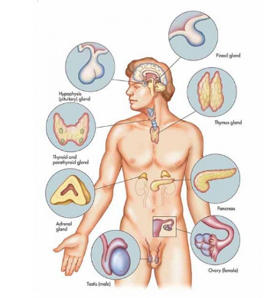
Endocrine System Overview
Structure:
A series of glands that secrete hormones into the bloodstream.
Different glands secrete different hormones.
Function:
To maintain the internal conditions required for health by:
Detecting changing internal conditions
Producing hormones that affect body cells
Releasing these hormones as chemical messengers that enter cells, changing their function to restore internal conditions.
Learning Aim: Describe the function of the endocrine system

Slide 7
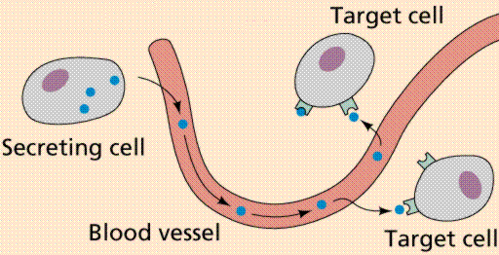
What are hormones?
Are chemical messengers secreted from endocrine glands into the blood.
Hormones interact with receptors on or in cells and affect cell function.
Learning Aim: Define hormones

Slide 8
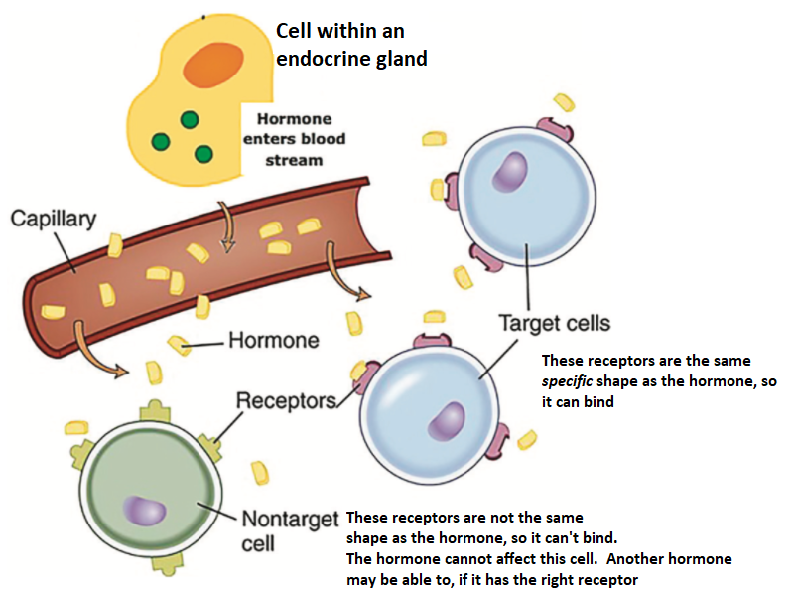
Hormone Receptors
Receptors are proteins on or in cells, to which hormones can bind.
Receptors are specific – each type of receptor can only bind with one type of hormone.
Some hormones affect all cells, because all cells have receptors for them.
Some hormones only affect specific organs (target organs) or groups of cells (target cells), because only they have the correct receptors.
Different types of cells have different types and numbers of receptors. This is why there is variation in how and where different types of hormones act in the body.
Learning Aim: Explain how hormones interact with cells and which cells may be affected.

Slide 9
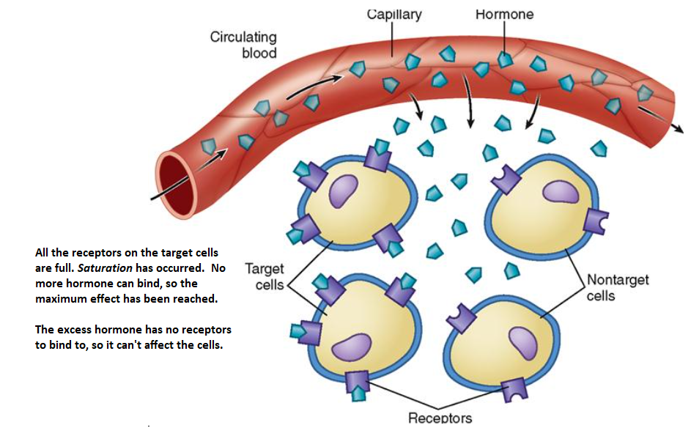
Hormone Saturation
Occurs when all receptor sites are filled, or saturated
At this point, the excess hormone can’t have any further effect because there is nowhere for it to bind.
Learning Aim: Describe hormone saturation

Slide 10
Target cell response to hormones
Different hormones can act in different ways within the target cell to change the type, activity or quantity of proteins produced.
They can:
Activate genes in the nucleus to produce specific enzymes or structural proteins
Change the shape or structure of enzymes to turn them ‘on’ or ‘off’
Change the rate of transcription and translation to change rate of protein production.
Example: Growth hormone increases the production of proteins involved in bone and muscle development.
Hormone clearance
Removal of hormones from action, by breaking them down.
This can happen:
In the target cells (sometimes)
In the liver and kidneys (mostly)
Excreted in bile and urine.
Learning Aim: Describe ways in which target cells respond to hormones, and how hormones are cleared from the body

Slide 11
Control of hormone secretions
Hormone action must be regulated so that stable internal conditions are maintained.
Over-secretion or under-secretion of a hormone will cause the body to function abnormally.
To maintain homeostasis, hormone production must be “switched off” once the hormone has done it’s job.
This is regulated by negative feedback systems:
Hormone levels are detected by the endocrine gland, which then stops producing that hormone when levels are normal.
Sometimes the hypothalamus is involved and produces inhibiting factors once the hormone has done its job.
Learning Aim: Briefly explain how hormone secretions are controlled.

Slide 12
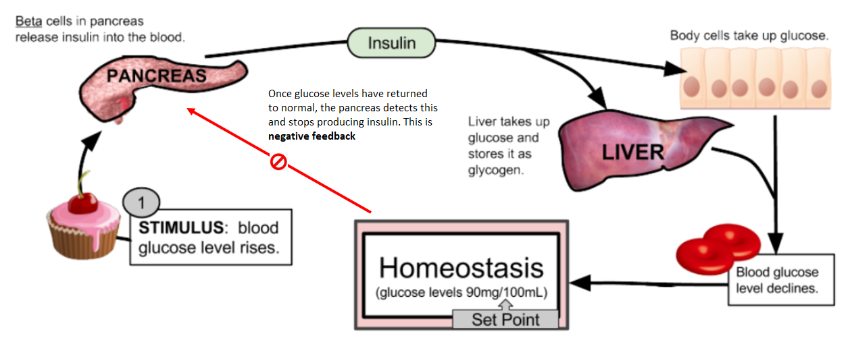
Example of negative feedback

